Slide 1
Assess Vendor-Managed Inventory (VMI) System for Military Aircraft Utilizing a Discrete-Event Simulation Model
Yunshi Zhao – Yunshi.zhao@asdl.gatech.edu

Slide 2
Outline
Introduction
Motivation
Problem Statement
Approach
Overview of Sustainment Procedures
Conventional System V.S. VMI System
Modeling Environment
Performance Metrics
System Stress Factors
Length and Repetitions of Runs
Results
Introduction
Motivation
Problem Statement
Approach
Results

Slide 3
Military Sustainment
Sustainment: “The provision of logistics and personnel services required to maintain and prolong operations until successful mission accomplishment.” (JP 3-0) ^{[1]}
Introduction
Motivation
Rate of parts break
Aircraft Reliability
Problem Statement
Sustainment Resources
Personnel, facilities, inventory, etc.
Approach
How many flight hours? Peacetime or war time? Surge?
Sustainment Performance
Operation
Results
Metrics:
Operational Availability – AO
Operational Reliability – RO
Supply Chain
Replenish sustainment resources
When and under what condition aircraft are maintained?
Maintenance

Slide 4
Motivation
In 2010, according to the Department of Defense, operation & support costs make up over 60% of the total lifecycle cost of a military system^{[5]}
The United States Air Force spent over $50 billion on Operations & Maintenance (O&M) activities, with $8 billion alone going to O&M for its primary combat forces ^{[3]}
O&M costs consistently increase by 2 to 3 percent per year after inflation ^{[2]}
Unnecessary maintenance activities accounts for as much as 33% of the total maintenance costs^{[4]}
Introduction
Motivation
Problem Statement
Approach
Results

Slide 5
Paradigm Shifts
Vendor supplied performance based logistics (PBL)
Developed in response to the death spiral of decreasing readiness and increasing costs in the 1990s
Deliver performance outcomes as defined by performance metrics for a system or product rather than contracting for the acquisition of goods and services
Outsource to the contractor which can have many synergistic effects for both parties: lower maintenance overhead, leaner part inventory, and a more efficient supply chain
Introduction
Motivation
Problem Statement
Approach
Results

Slide 6
Vendor Supplied PBL
Preventive and Reactive Maintenance
Condition Based Maintenance
Introduction
Preventive Maintenance: Replace parts when statistics suggest they need to be replaced (Scheduled)
Reactive Maintenance: When above predictions do not catch failures in time to prevent them
(Unscheduled)
Prognostic Health Management (PHM): Monitor aircraft component health through a vast array of sensors and data monitoring routines.
Distributed Information System (DIS): The information collected by PHM is shared globally through the DIS
Motivation
Problem Statement
Approach
[5]
Results
Contract to refurbish spare parts when they break and manage spare inventory levels across the Air Force
Government-Owned and Managed
Organically Managed Inventory
Vendor Managed Inventory

Slide 7
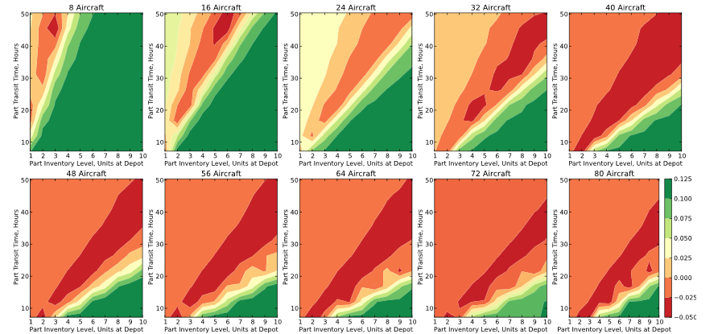
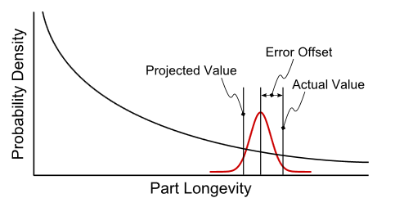
Previous ASDL Efforts
Preventive and Reactive Maintenance
Condition Based Maintenance
Introduction
Motivation
Problem Statement
Approach
Results
[6]
Organically Managed Inventory
Vendor Managed Inventory

Slide 8
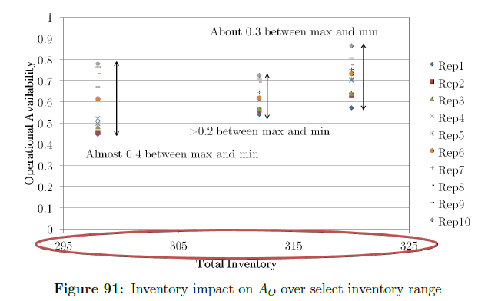
Previous ASDL Efforts
Preventive and Reactive Maintenance
Condition Based Maintenance
Introduction
Maintenance is performed based on a condition based maintenance policy, stochasticity will dominate the performance of sustainment ^{[7]}
Motivation
Problem Statement
Approach
Results
[7]
Organically Managed Inventory
Vendor Managed Inventory

Slide 9
Problem Statement
Introduction
Motivation
To combine existing simulation resources to model the impact of VMI system on fleet level operations of military fighter aircraft
Problem Statement
Approach
Results

Slide 10
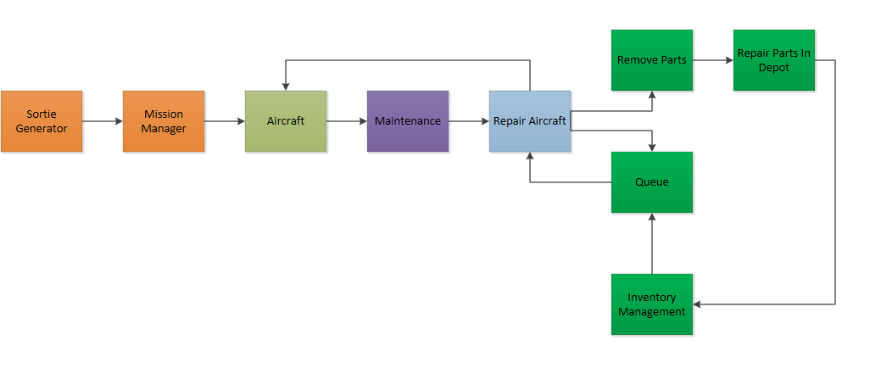
Overview of Sustainment Procedures
Introduction
Motivation
Problem Statement
Approach
Results

Slide 11
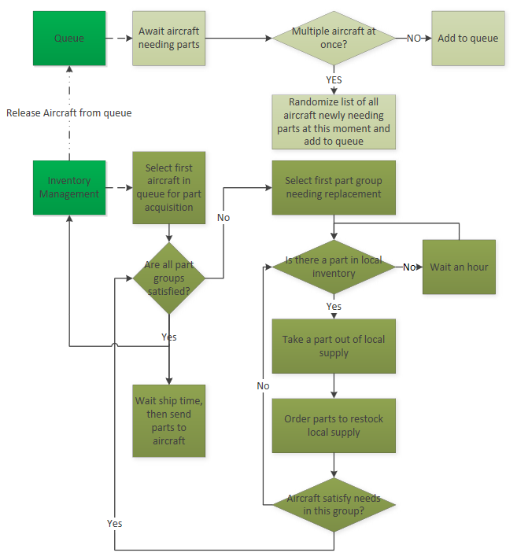
Conventional Inventory Management
First-In-First-Out
Only Local Inventory
Each base operates its depot, and restocks supplies once a part taken from inventory
Introduction
Motivation
Problem Statement
Approach
Results

Slide 12
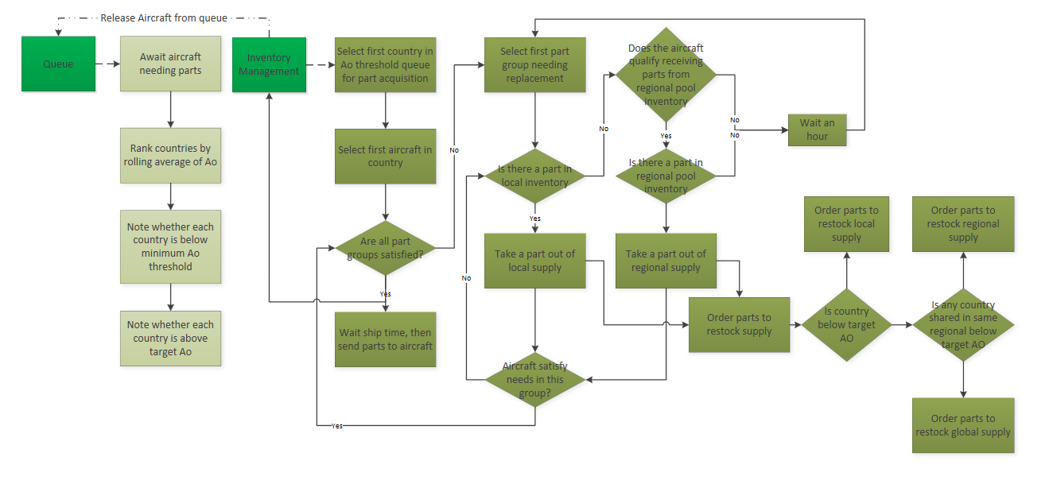
Vendor Managed Inventory System
Introduction
Motivation
Problem Statement
Approach
Results
Queue sorted by performance
Regional and global pools besides local pools
Set of rules determining if one is eligible to take parts from certain pools
Set of rules determining if pools is eligible for replenishment

Slide 13
Modeling
Mathematical Models
Fast
Can’t capture time dependent behavior
Agent Based Models and System Dynamics Models
Monitor system’s behavior over time
Long run time
Discrete Event Simulation
Relatively short run time
SimPy (Python)
Introduction
Motivation
Problem Statement
Approach
Results

Slide 14
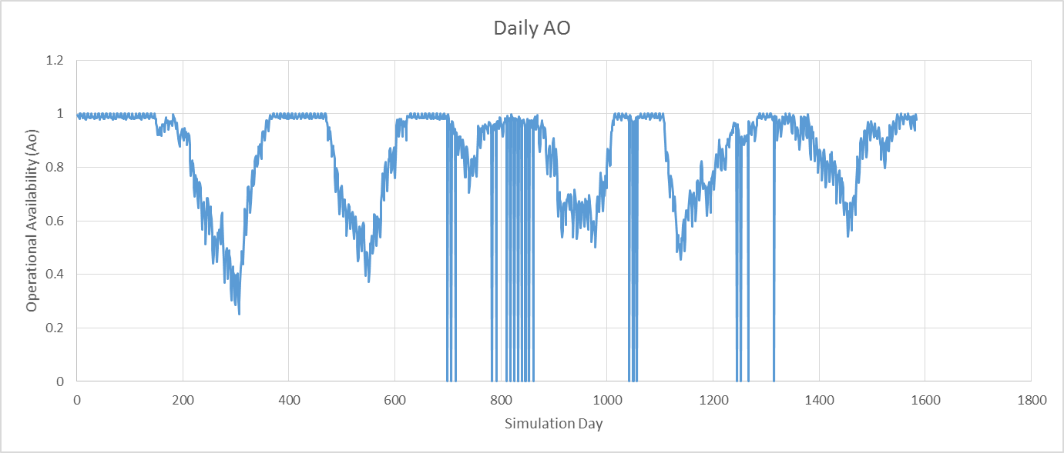

Performance Metrics
Operational Availability
Primary metric for performance based logistics contracts as well as being a good overall measure of collective system performance
Overall
A fraction representing total system uptime over certain time period:
Target Ao of 70% according to the Air Force^{[8]}
$A_{o}=\frac{T_{a}+T_{f}}{T_{a}+T_{f}+T_{wr}+T_{wp}+T_{br}}$
Daily
Percent of Days Achieve Target Ao
An example run on the right:
80% overall Ao, but
During 22% of total simulation days
Ao below 70% were resulted
Introduction
Motivation
Problem Statement
Approach
Results

Slide 15
System Stress Factors
 | Daily Missions | # of AC | Mission/Day | Inventory Level
Base 1 | 10 | 14 | 0.73 | 196
Base 2 | 20 | 27 | 0.73 | 392
Base 3 | 30 | 41 | 0.73 | 588
Base 4 | 40 | 55 | 0.73 | 784
Base 5 | 50 | 68 | 0.73 | 980
Base 6 | 60 | 82 | 0.73 | 1176
Base 7 | 70 | 96 | 0.73 | 1373
Base 8 | 80 | 110 | 0.73 | 1569
Base 9 | 90 | 123 | 0.73 | 1765
Base 10 | 100 | 137 | 0.73 | 1961
Base 11 | 110 | 151 | 0.73 | 2158
Base 12 | 120 | 164 | 0.73 | 2353
Base 13 | 130 | 178 | 0.73 | 2549
Base 14 | 140 | 192 | 0.73 | 2745
Base 15 | 150 | 205 | 0.73 | 2942
15 Bases
Base 1 as the smallest fleet and Base 15 as the largest fleet
To observe the relation between fleet sizes and increase in Ao from transitioning to VMI system
Daily Missions/AC
Operation Load
Part Transit Time
Supply Chain Efficiency
Inventory Level
Resources
Costs
Introduction
Motivation
Problem Statement
Approach
Results
Level | 1 | 2 | 3 | 4 | 5
Number of Mission/AC/Day | 0.73 | 0.85 | 0.97 | 1.09 | 1.21
Level | 1 | 2 | 3 | 4
Transit Time from Depot to Local | 72 | 108 | 144 | 180
Transit Time from Depot to Pool | 36 | 72 | 108 | 144
Transit Time from Pool to Local | 36 | 36 | 36 | 36
Level | 1 | 2 | 3 | 4
Local Inventory Level | 1 | 0.95 | 0.9 | 0.85

Slide 16
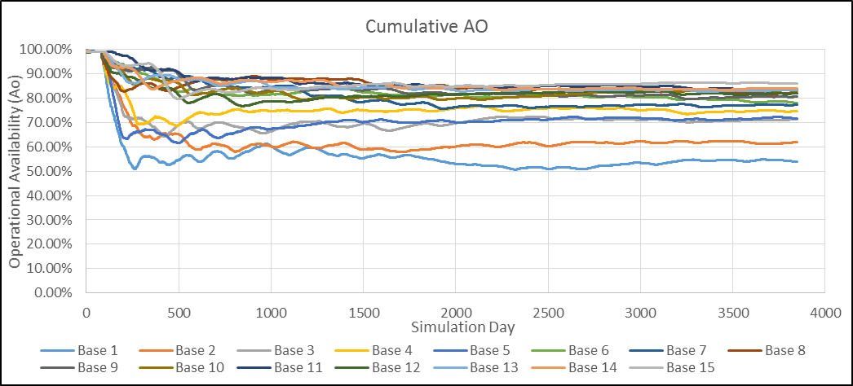
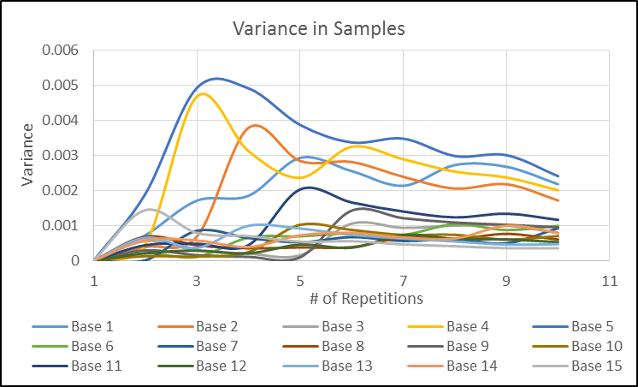
Length and Repetitions
Simulation Days:
2500 days
Cumulative Ao became relatively steady between 2000th and 2500th day
Introduction
Motivation
Problem Statement
Approach
Simulation Repetitions
8 Repetitions
Decrease in variance became fairly small after 8 repetitions
Results

Slide 17
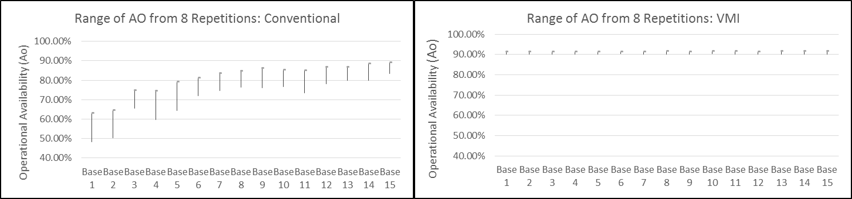
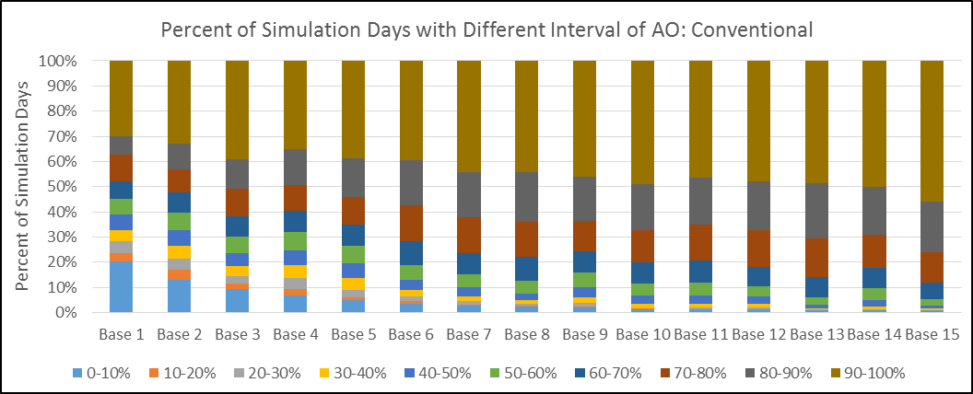
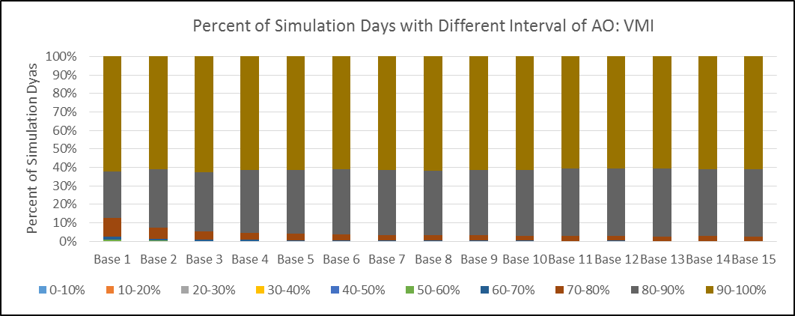
Baseline Comparison
Introduction
Motivation
Problem Statement
Approach
Results

Slide 18
Increasing Operational Load Per AC
Introduction
Motivation
Problem Statement
Approach
Results
Small size bases were most benefited from VMI
For Base 1-6, the improvement in performance was not affected by the levels of operational load
As the sizes of the bases continued increasing, the number of daily missions per aircraft started affecting the performance improvement. The improvement in performance was bigger when system was stressed

Slide 19
Increasing Part Transit Time
Introduction
Motivation
Problem Statement
Approach
Results
At low levels of part transit time, the performance improvement was higher for smaller size base
After the part transit time reached 144 hours, the improvement in performance were similar for all bases at the same part transit time level
Improvement performance was not affect by the size of bases, instead the improvement was directly related to levels of the part transit time

Slide 20
Decreasing Inventory Level
Introduction
Motivation
Problem Statement
Approach
Results
Bigger increase in Ao performance for small size bases at low stress level, and improvement waw relatively steady as the systems continued being stressed
For larger size base, the improvement was lower compared to ones for smaller size bases at the same stress level
For larger size base, improvement in performance increased as the inventory level decreased to 90% of default value, then it decreased again as the inventory level further decreased

Slide 21
Reference
[1] Mullen, M., “Joint publication 3-0: Joint operations," 2011.
[2] United States Department of Defense, “Dod weapon system acquisition reform product support assessment," tech. rep., November 2009.
[3] Office of the Undersecretary of Defense (Comptroller), “Operation and maintenance programs (o-1) revolving and management funds (rf-1),“ tech. rep., United States Department of Defense, 2012.
[4] Mobley, R. K., An Introduction to Predictive Maintenance. Elsevier, 2002.
[5] United States Department of Defense, Office of the Secretary of Defense, Cost Assessment Program Evaluation Office, "O&S Cost as Percent of Total Ownership Cost (TOC)," US DoD, 2009.
[6] Offensend, C. D., “Implementing an Autonomic Logistics System in a Discrete Event Simulation to Assess the Operational Availability of Multi-Role Fighter Aircraft,” AE8900MAV Special Problems, May 2013.
[7] Saltmarsh, E., “A Modeling Trade-Off Forecasting Environment for Military Aircraft Sustainment,” Georgia Institute of Technology, May 2015.
[8] United States Air Force Scientific Advisory Board, “Sustaining air force aging aircraft into the 21st century," tech. rep., United States Air Force, 2011.

Slide 22
Backup Slides

Slide 23
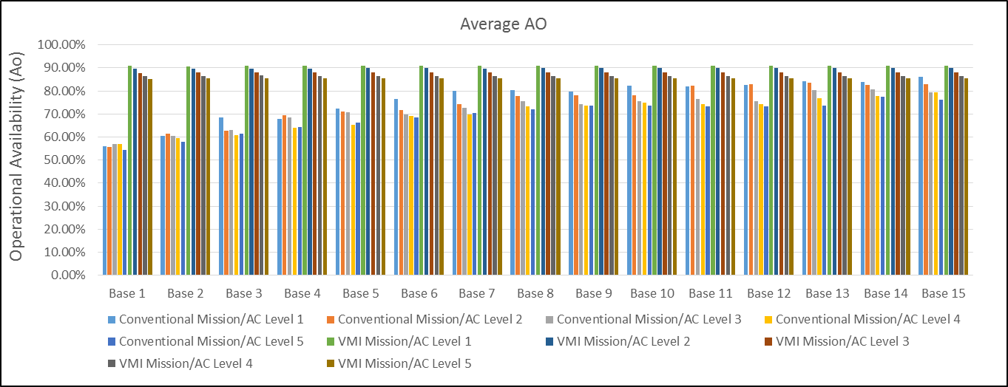
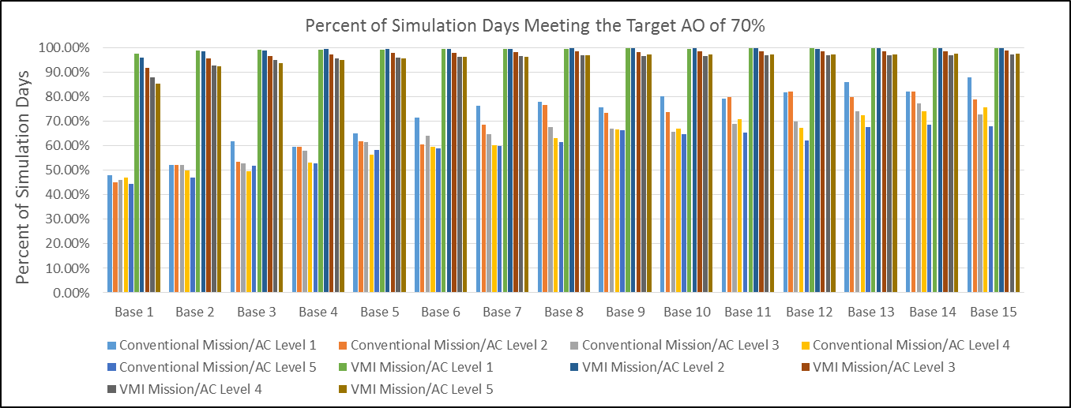

Slide 24
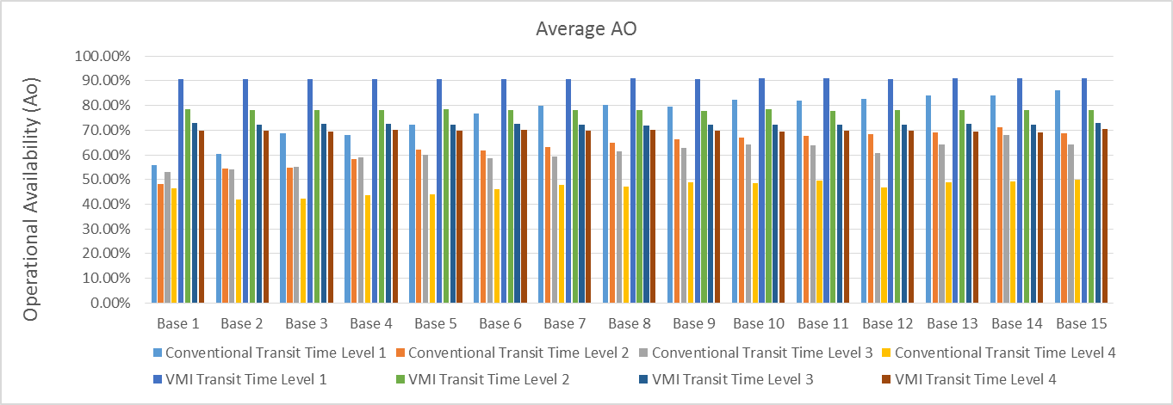
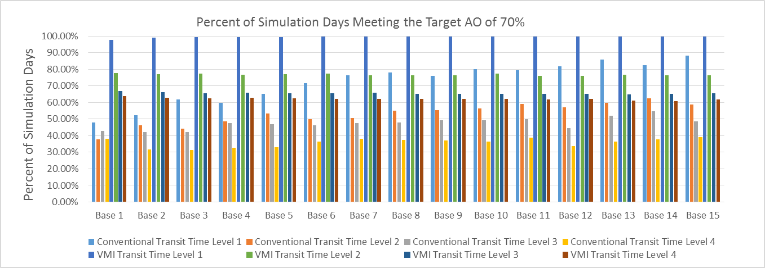

Slide 25
